Slide 1

CATATHON 2021
MACHINE ANAMOLY PREDICTION USING PRODUCT LINK DATA
A PRESENTATION BY:
Harini A
Dhanush M

Slide 2
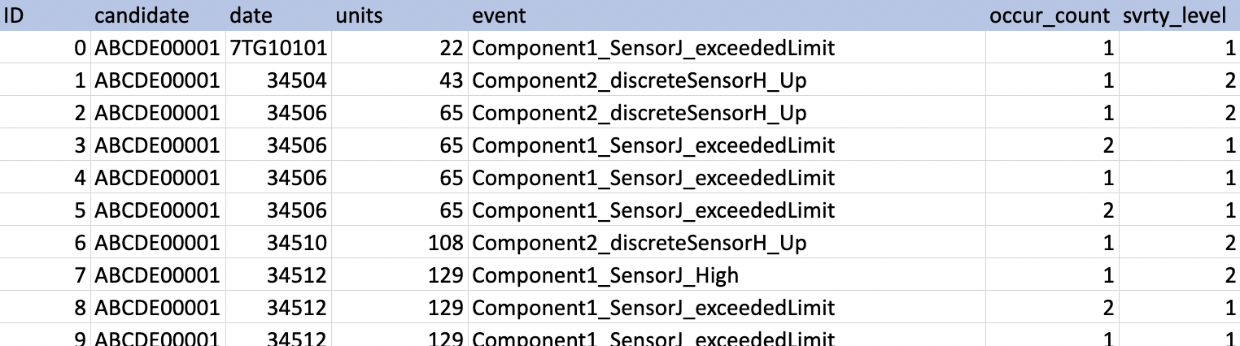
What was given to us?
An excel sheet containing a million data entries. (Yes, a million!)
We believe these are what are called as Telematics Data provided to us by sophisticated IoT powered devices from Cat Product Link
Each data entry consisted of :
Machine ID
Candidate name
Date
Units
Event
Occurrence count
Severity level

Slide 3

Solution 1

Slide 4
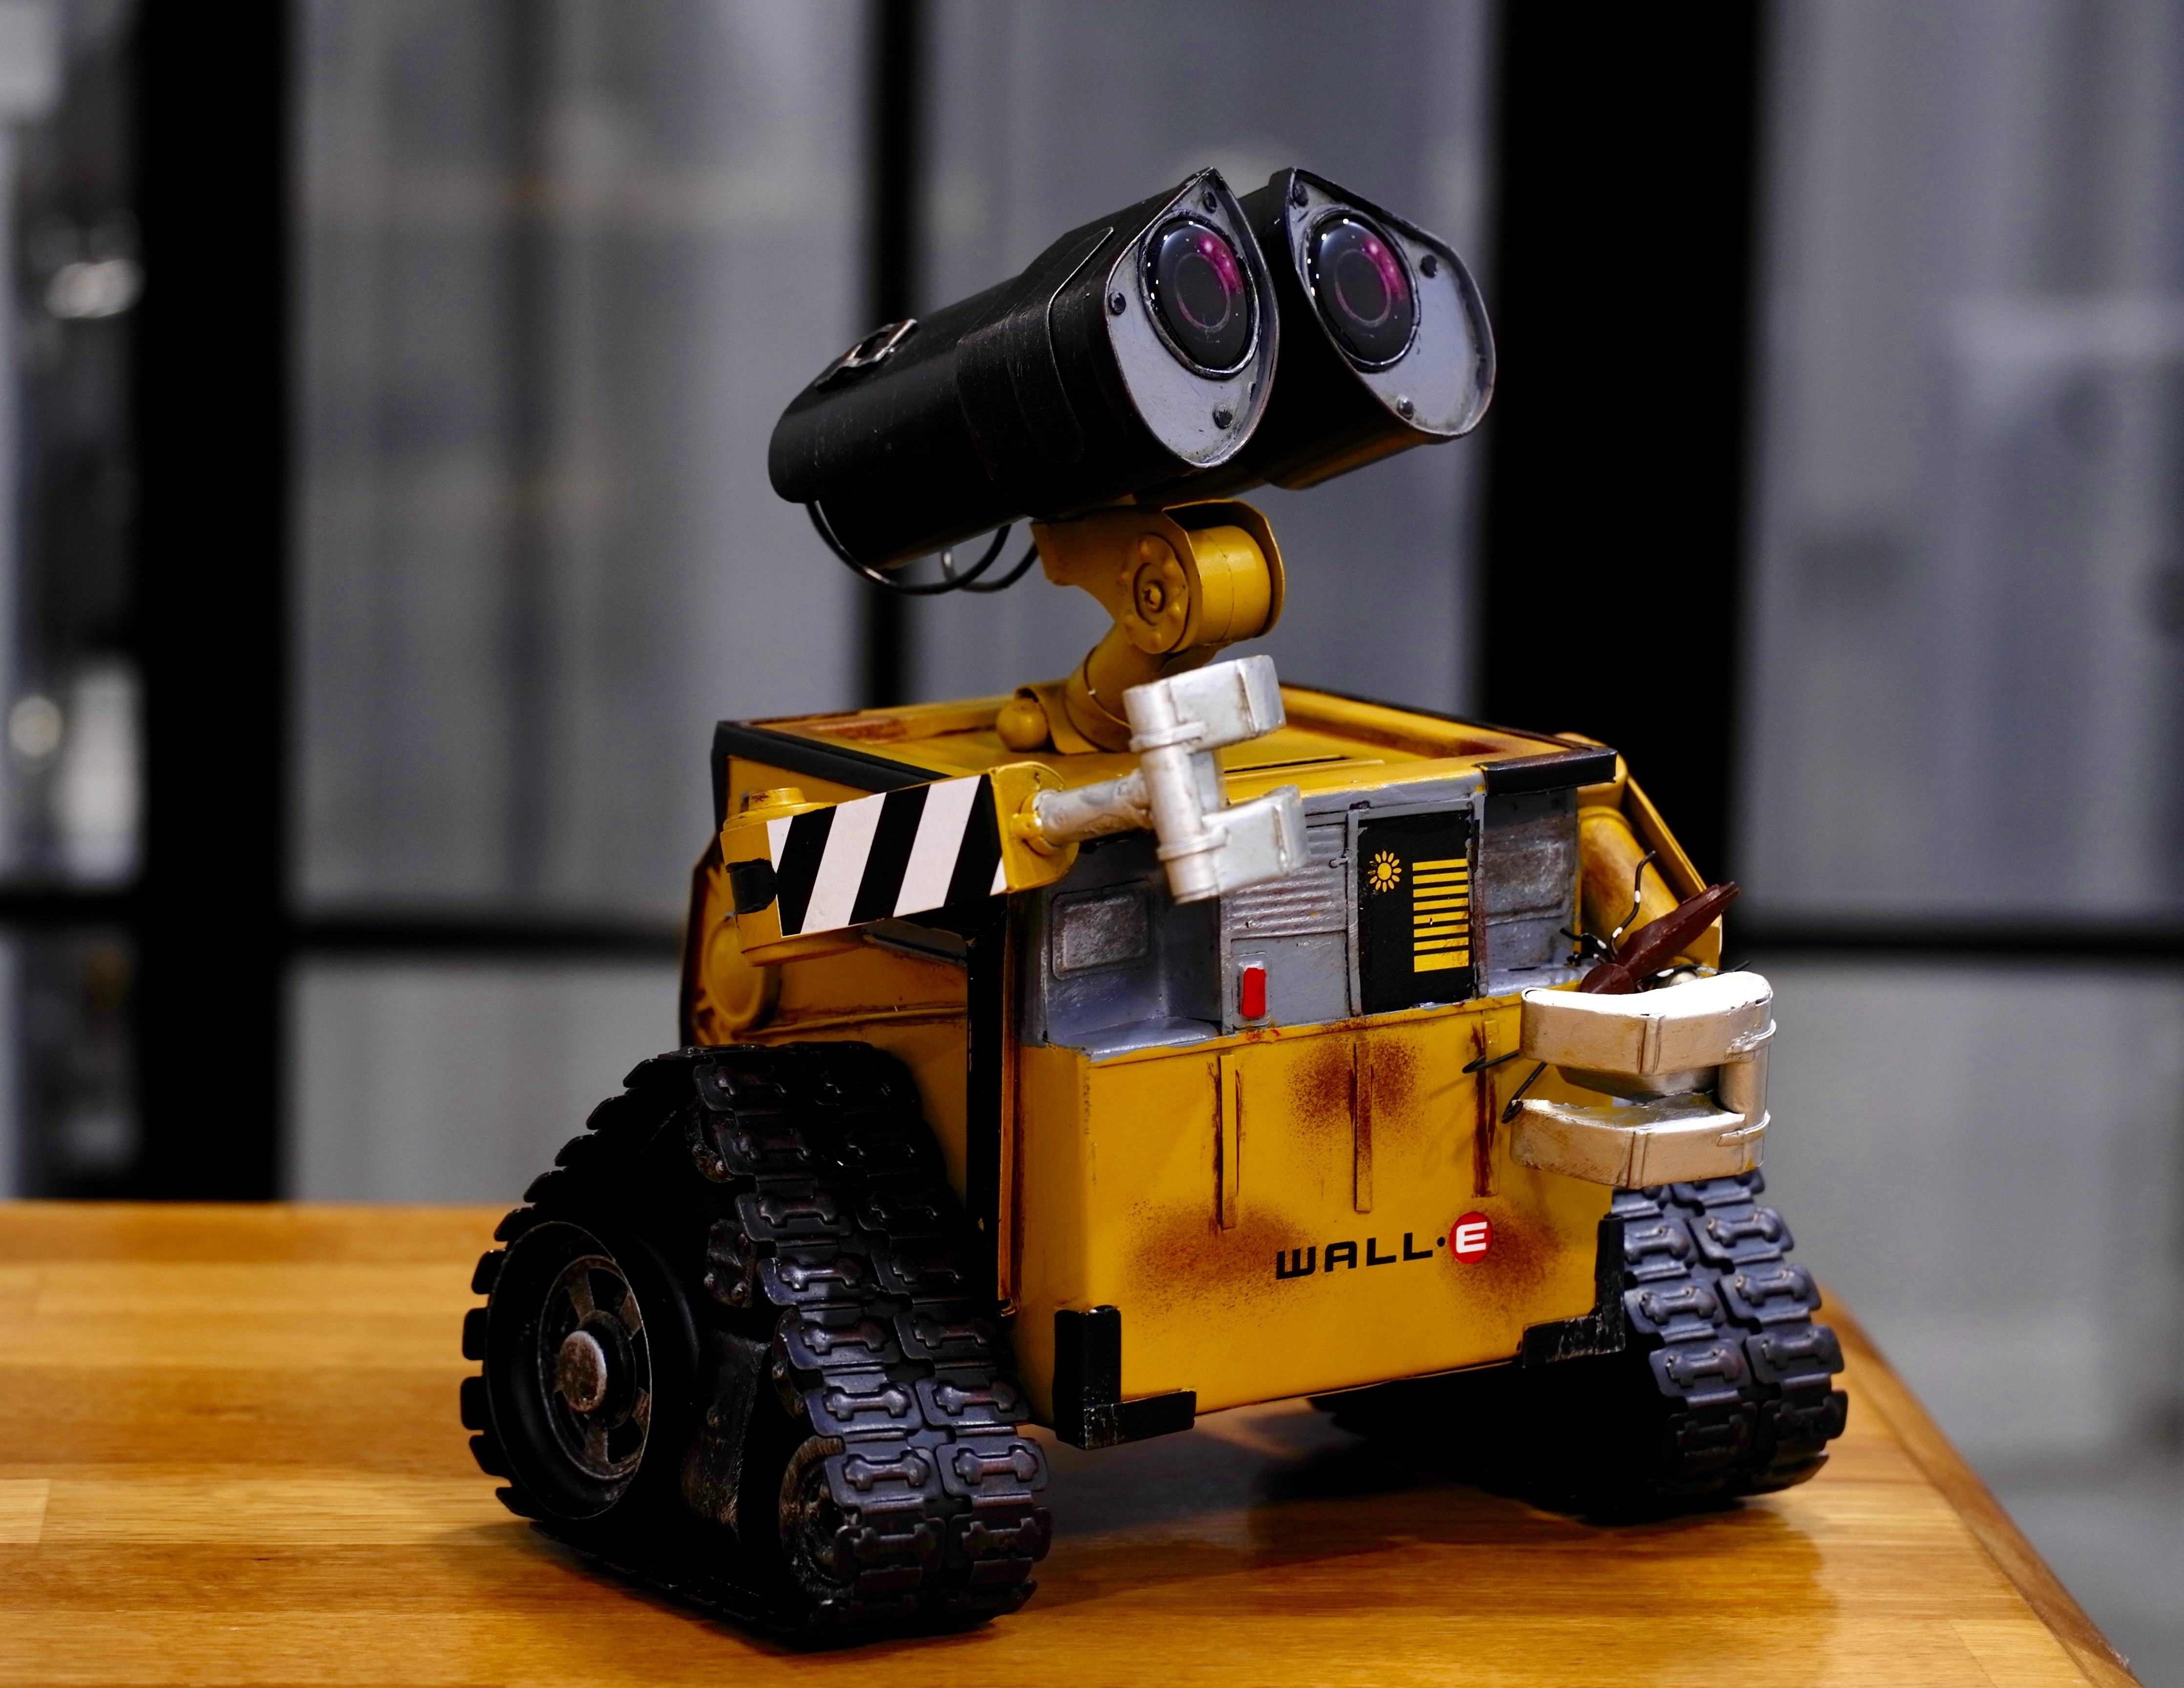
Use Simple Linear Regression!
Solution 1

Slide 5

How we interpreted the given data for this idea?
Group the given data with respect to their candidate's name.
This is under an assumption that machines of the same candidate's name display similar behavior.
We plotted and analyzed the trends of units and date for each candidate.
We also assumed the date field to hold units as minutes

Slide 6
What we observed..
It was observed that the plots showed a linear trend.
We inferred that the units were directly proportional to the date(time lapsed)
However, there were some flat intervals where we assumed that the machine was idle.

Slide 7
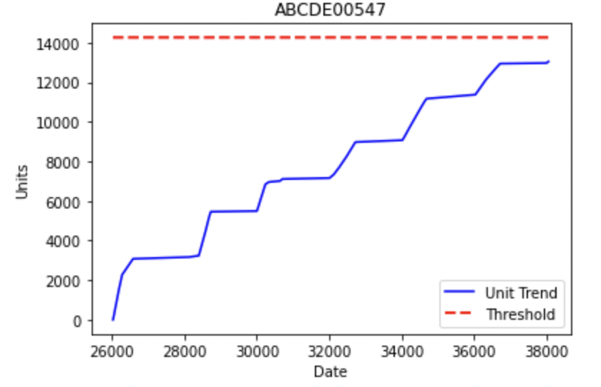
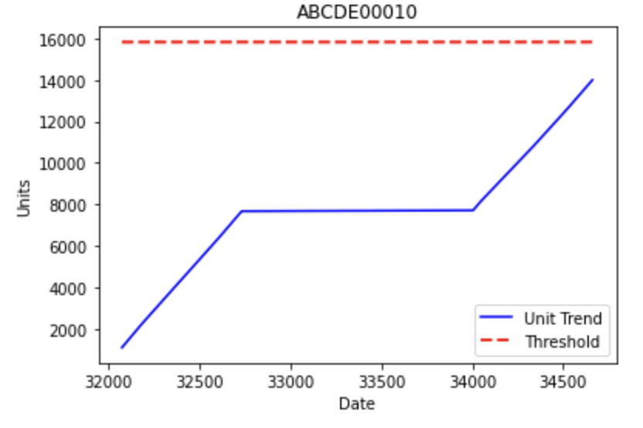
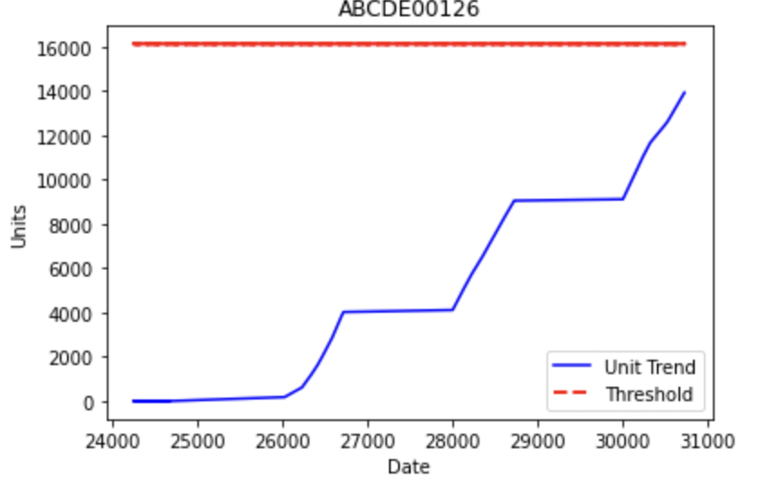
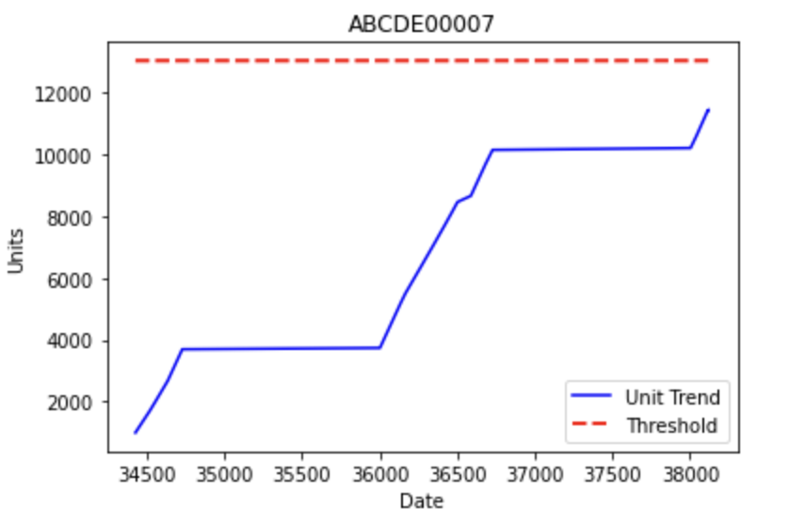

Slide 8
How to predict machine failure?
For a given candidate,
We fixed our threshold value of units where the engine would fail to be,
Threshold = max(units) + 0.5(sd(units))
After fitting the hypothesis through linear regression and having known the threshold, we will be able to calculate the time at which the machine would reach threshold units.
We also would be able to calculate the current position of the machine in the timeline by feeding in the current units reading to our hypothesis function.
If we assume the trained hypothesis function to be 'PredictFailure(units)',
Time to Failure = PredictFailure(Threshold) - PredictFailure(CurrentReading)
NOTE: We can also use the other parameters such as occurrence count, severity level,encoded events to train our model. But we felt that their weightage would not be very significant.

Slide 9
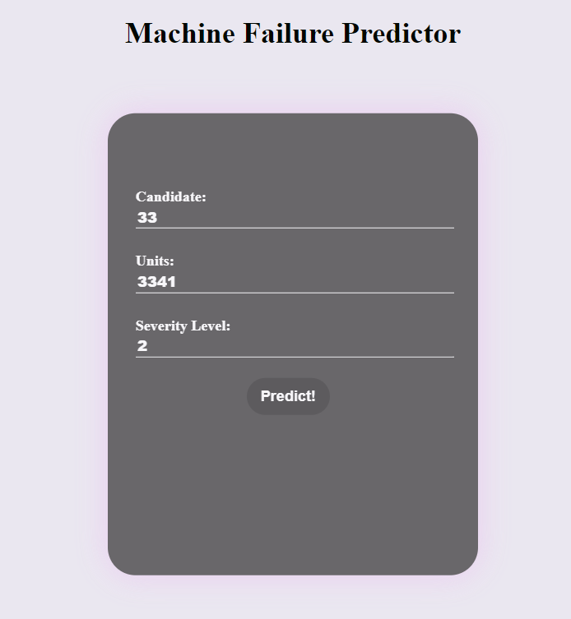
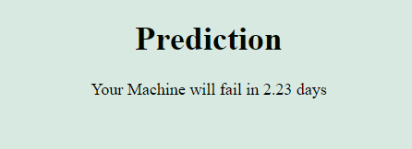
WEB-APP USING DJANGO
Here is a cool Django-based app that provides User-Interface that helps customers keep track of health of their Machine

Slide 10


WARNING: Some Python Code ahead!
Don’t worry!
We will be done before you know!😉

Slide 11
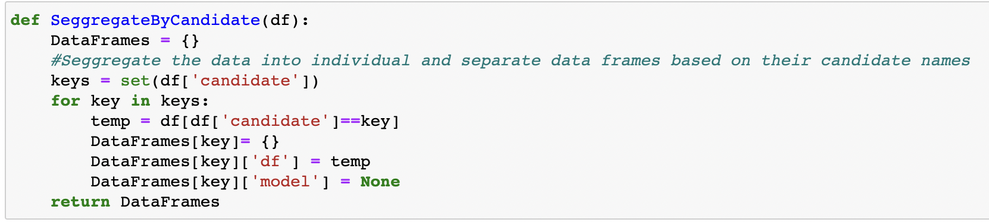
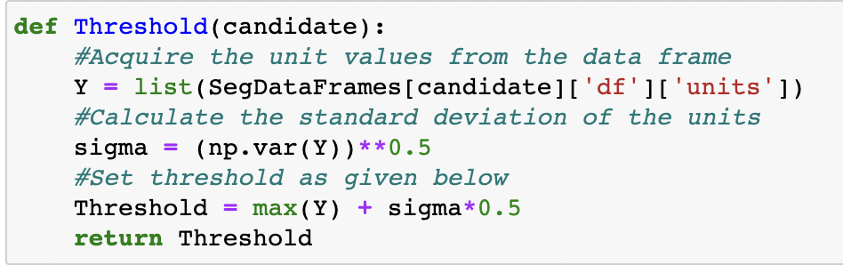

Slide 12
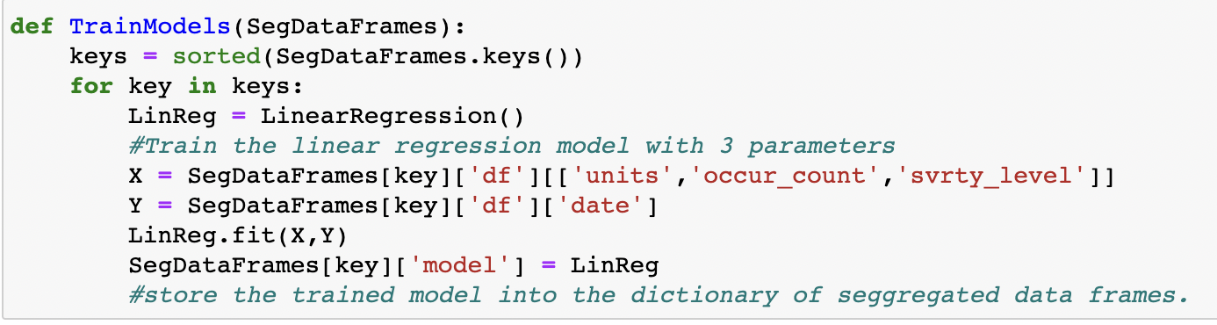
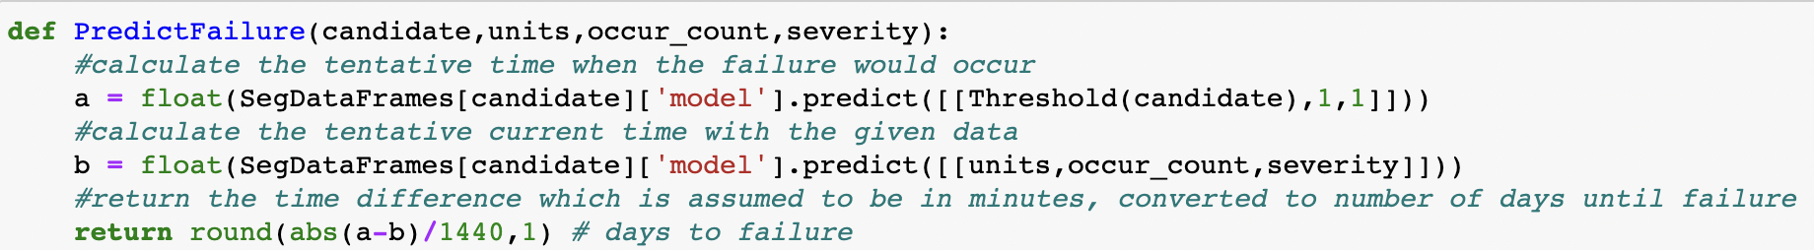

Slide 13
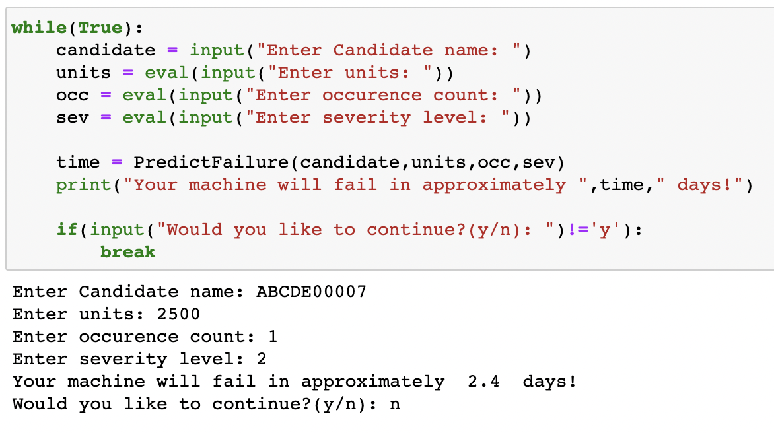

Slide 14

What's so bad about solution 1?
Does not deal with continuous data
The usage of the machine might not be in periodic intervals.
Irregular usage of machine, non-uniform idling time and running time can lead to bad results
Better to have the output in the form of number of running hours until failure

Slide 15
Solution 2

Slide 16
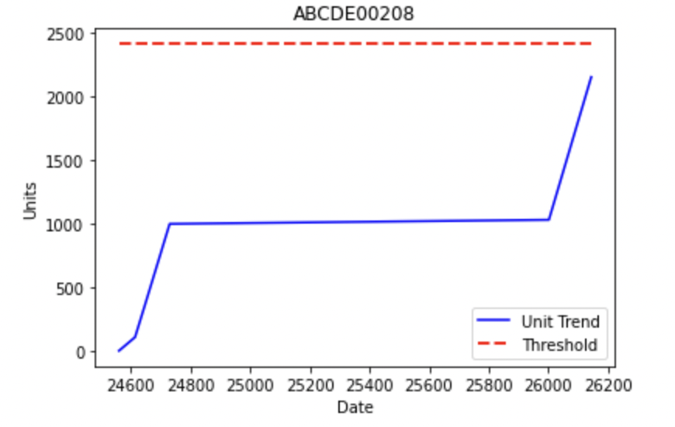
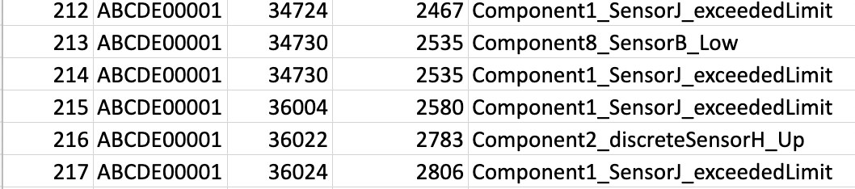
Identify whether the machine is idle or running..
We saw from the previous graphs that the trend was flat in between and was linearly increasing.
Observe that when the graph is increasing, it is increasing with similar slope always.
Finding this slope will give us the solution 2!
Solution 2
We also observed that the idle state implied that there was a huge gap in 'date' entries
Idle state

Slide 17
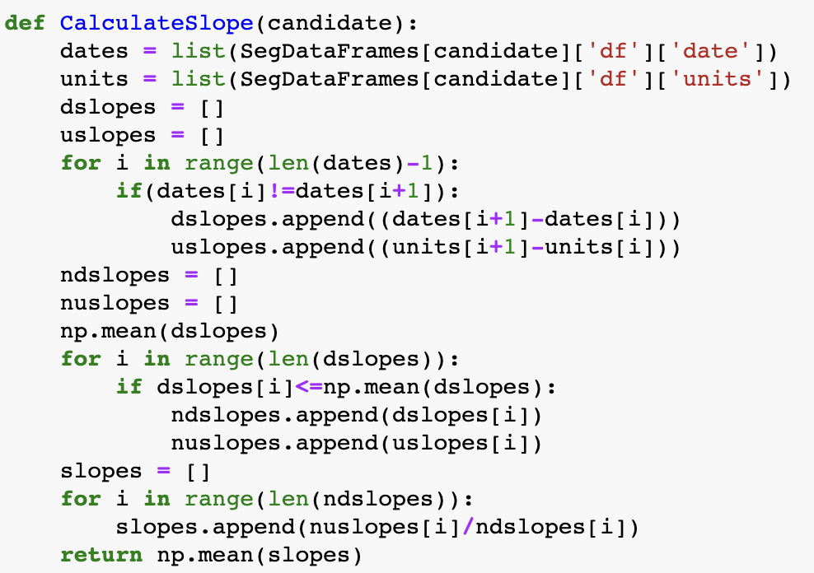
Code to find out the increase in 'units' w.r.t change in 'date'(time) Yes, we are talking about the slope of the curve when it is running!

Slide 18
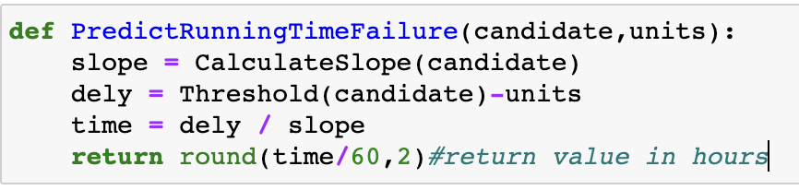
How to predict life of machine before it fails?
Having found out the slope of increase, now we can use the elementary formula for slope to find out the time in which the machine will fail.
slope = Δunits/Δtime
From this we can say that,
Δtime = slope/Δunits
Here Δtime denotes the number of minutes the machine would totally run (excluding idling time) before failure.

Slide 19
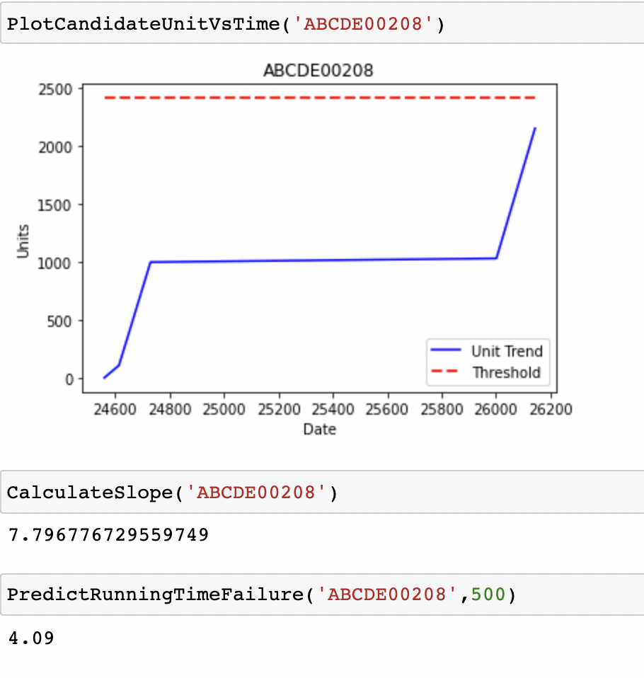
The algorithm in action..

Slide 20

Disadvantage of solution 2
We neglect the fact that the machine, when subject to continuous use is more vulnerable to fail while predicting the total run time before failure.

Slide 21

Thank you! We hope you liked our idea!

